Slide 1
Agricultural drought Monitoring using time-series satellite data and Google earth engine
By
Kaushal kathiriya (daiict - 202319013)
MIT borda (daiict - 202319008)
Under guidance of :
Mr. Abhishek Danodia
Department of agriculture & soil, iirs

Slide 2
Introduction
What is drought ?
Drought is a prolonged period of abnormally low precipitation resulting in a shortage of water supply, whether it be for agricultural, industrial, or domestic use.
Types of drought :
Meteorological Drought
Hydrological Drought
Agricultural Drought
What is Agriculture Drought ?
Agricultural drought is a type of drought that occurs when there is a shortage of moisture in the soil that negatively impacts the growth and yield of crops, leading to economic losses for farmers and food shortages for communities.

Slide 3
objective
To obtain a near real time monitoring of drought condition by using Google Earth Engine.
Spatial analysis to identify drought-affected areas, assess the spatial extent of drought impacts, and prioritize areas for intervention and resource allocation.
To develop interactive maps and charts to visualize drought information.

Slide 4
Study Material
Data Source :- Google Earth Engine.
Time Period :- From 2000 to 2023, Kharif season (July, August, September, October).
Sr.no. | Dataset | Variable | Period | Resolution | Source
1 | Rainfall CHIRPS | PCI | 2000-2023 | 0.05° | UCSB/CHG
2 | NDVI MODIS/061/MOD13Q1 | VCI | 2000-2023 | 250 Meters | NASA LP DAAC at the USGS EROS Center
3 | LST MODIS/061/MOD11A2 | TCI | 2000-2023 | 1000 Meters | NASA LP DAAC at the USGS EROS Center

Slide 5
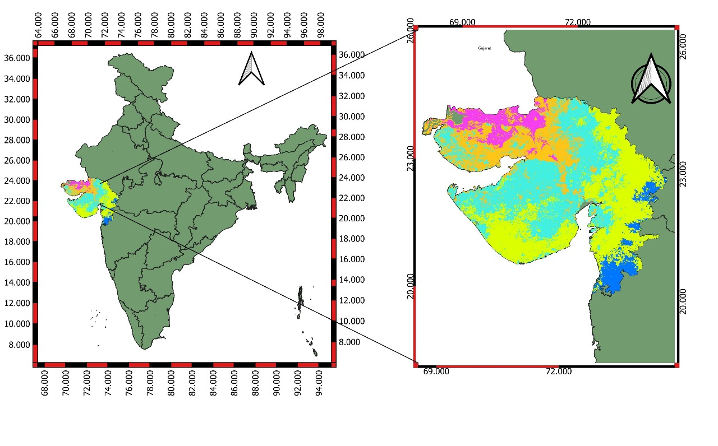
Study AREA

Slide 6
INDICES
Sr No. | Indices | Formula
1 | Vegetation Condition Index (VCI) | VCI = (NDVI - NDVImin) (NDVImax - NDVImin)
2 | Temperature Condition Index (TCI) | TCI = (LSTmax - LST) (LSTmax - LSTmin)
3 | Precipitation Condition Index (PCI) | PCI = (RF - RFmin) (RFmax - RFmin)
4 | Combined Drought Index (CDI) | SDCI = (α*PCI) + (β*VCI) + (γ*TCI) (α =0.53 , β =0.33, γ =0.14 )

Slide 7


methodology
MODIS
NDVI
MODIS
LST
CHIRPS
RAINFALL
Data Collection & Processing
Extraction, Rescaling, Reclassified
Vegetation Condition Index
Temperature Condition Index
Precipitation Condition Index
Weightage overlay & Integration
Analytical Hierarchy Process(AHP)
Analytics
Combined Drought Index
Map Formation
Result

Slide 8
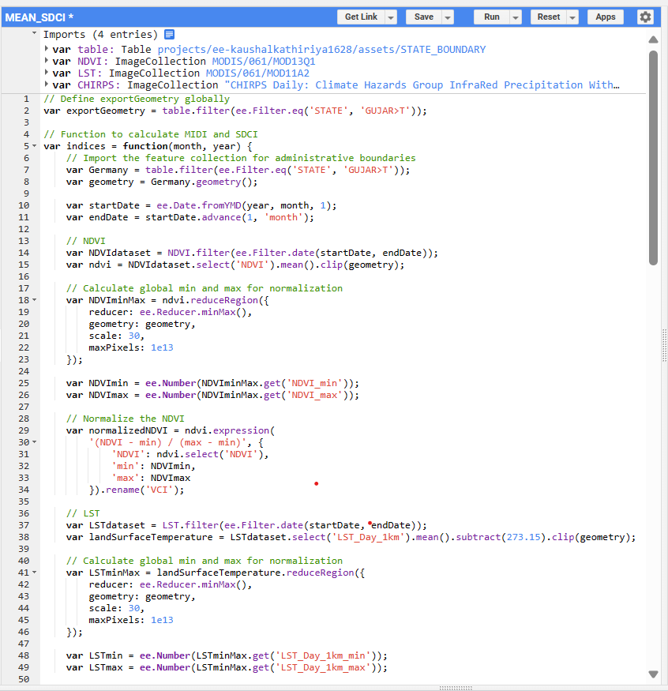
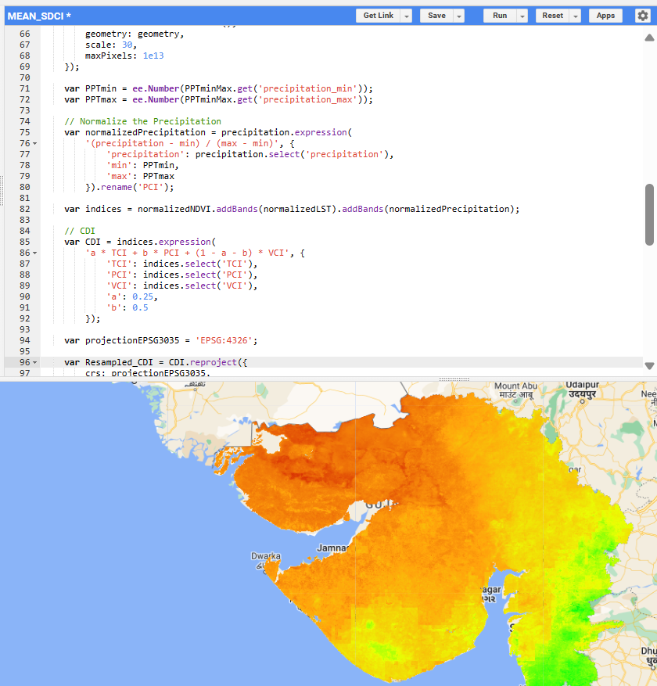
Snippets

Slide 9
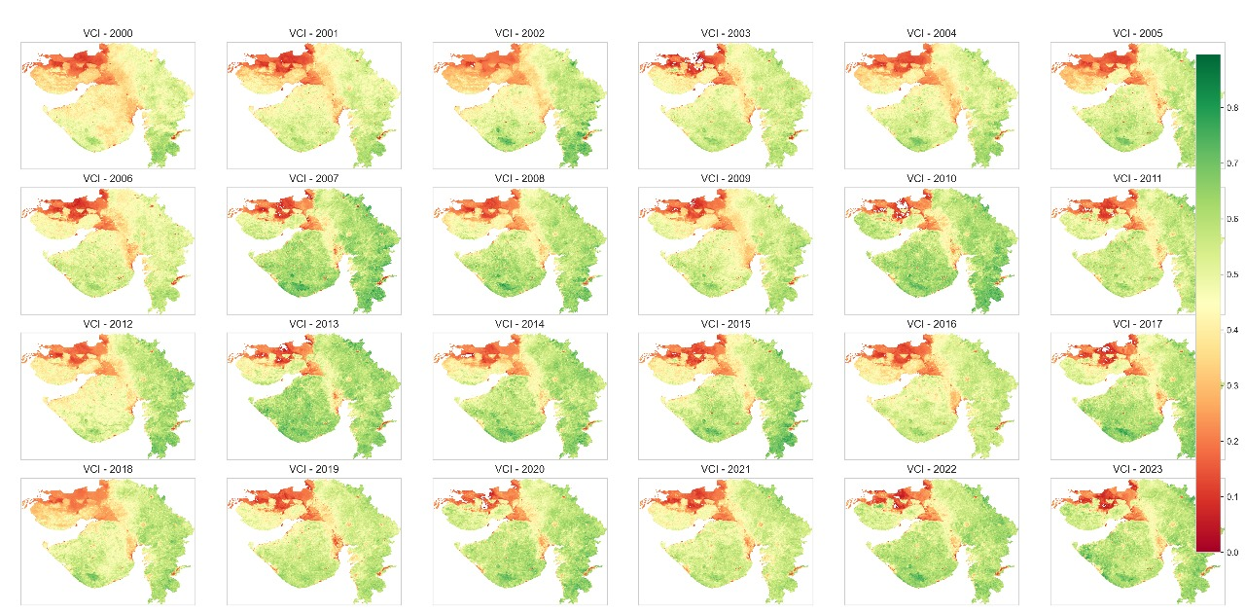
Vegetation Condition Index (VCI)

Slide 10
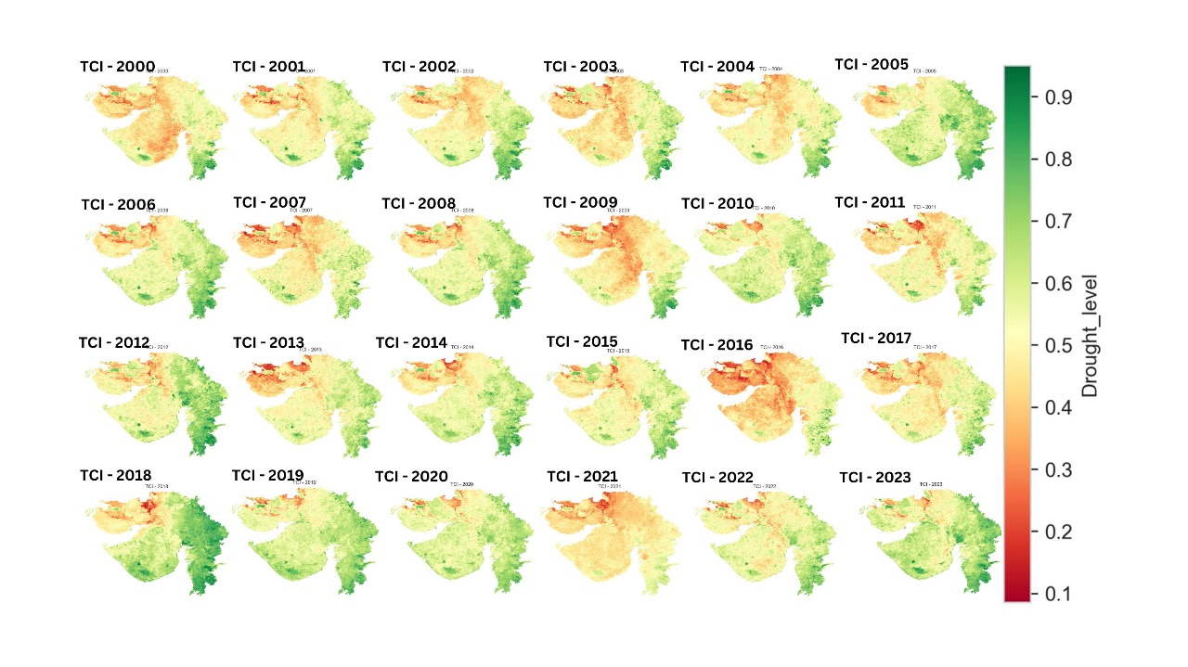
Temperature Condition Index (TCI)

Slide 11
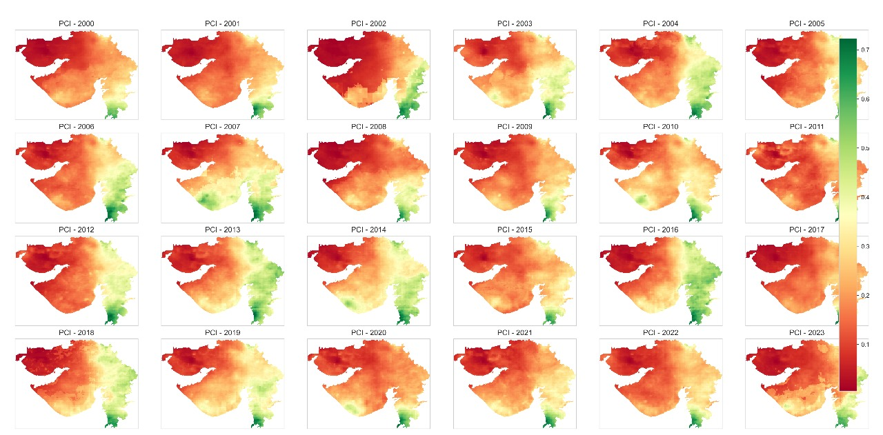
Precipitation Condition Index (PCI)

Slide 12
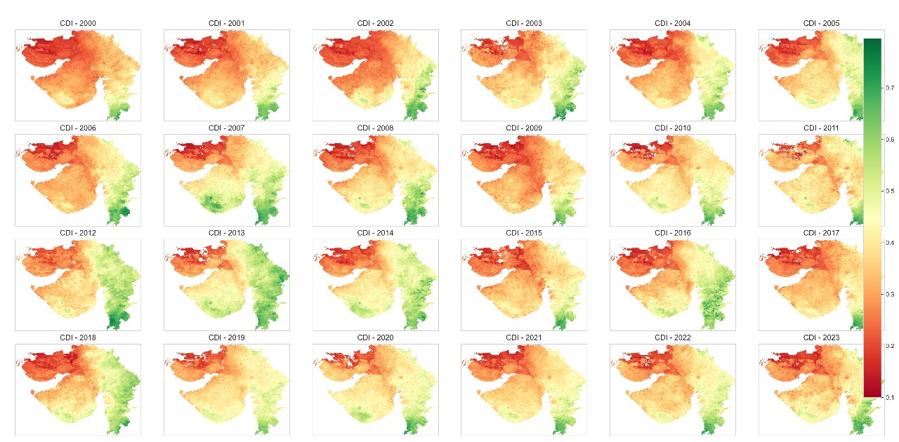
Combined drought index (cdi)

Slide 13
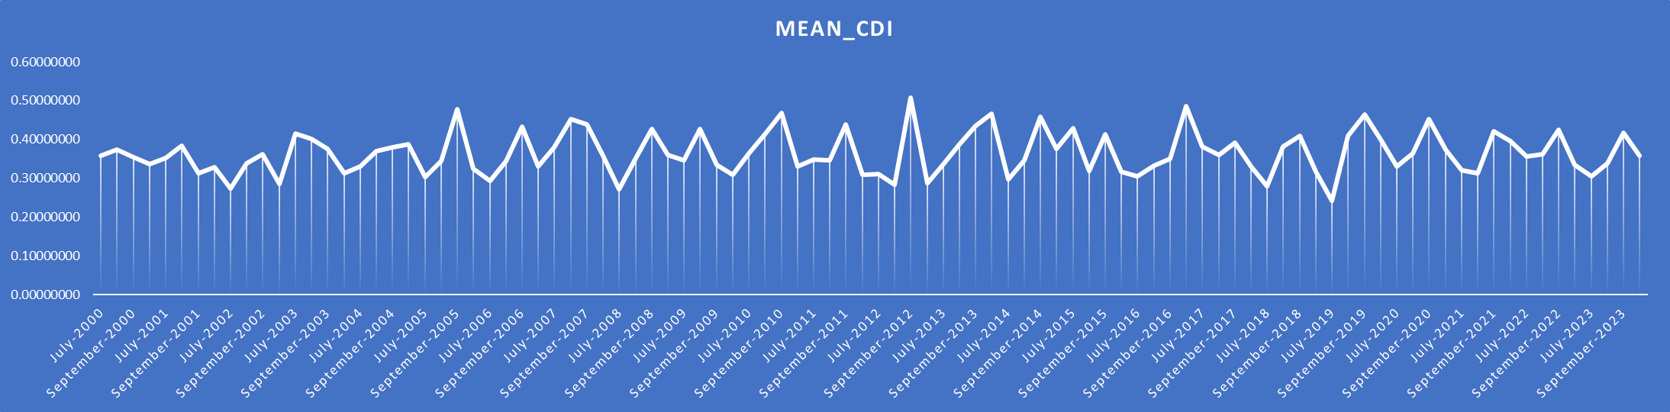
TIME SERIES OF COMBINED DROUGHT INDEX(CDI)

Slide 14
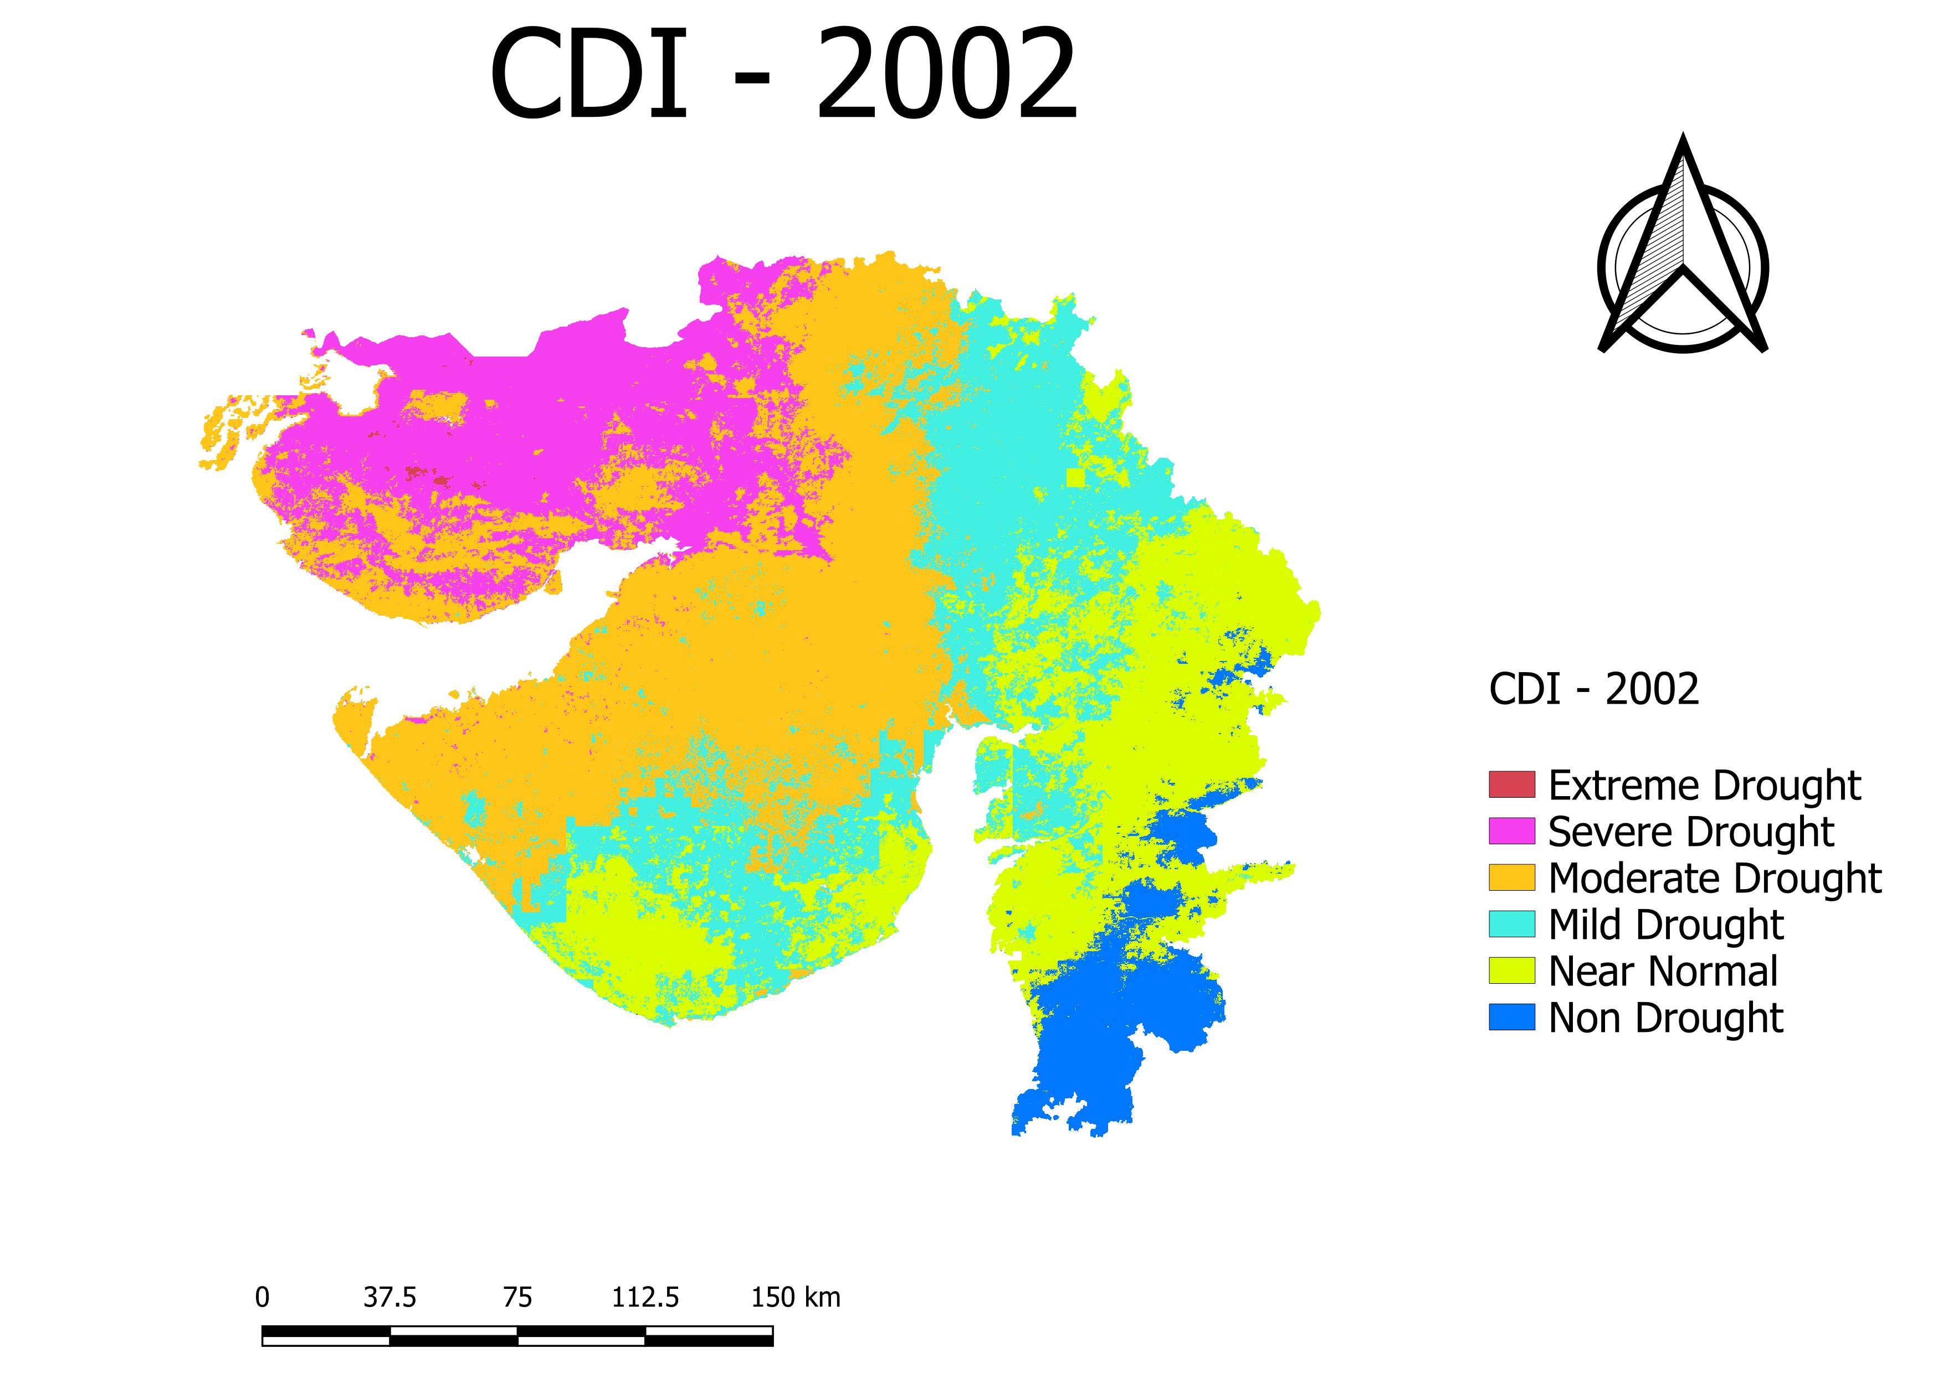
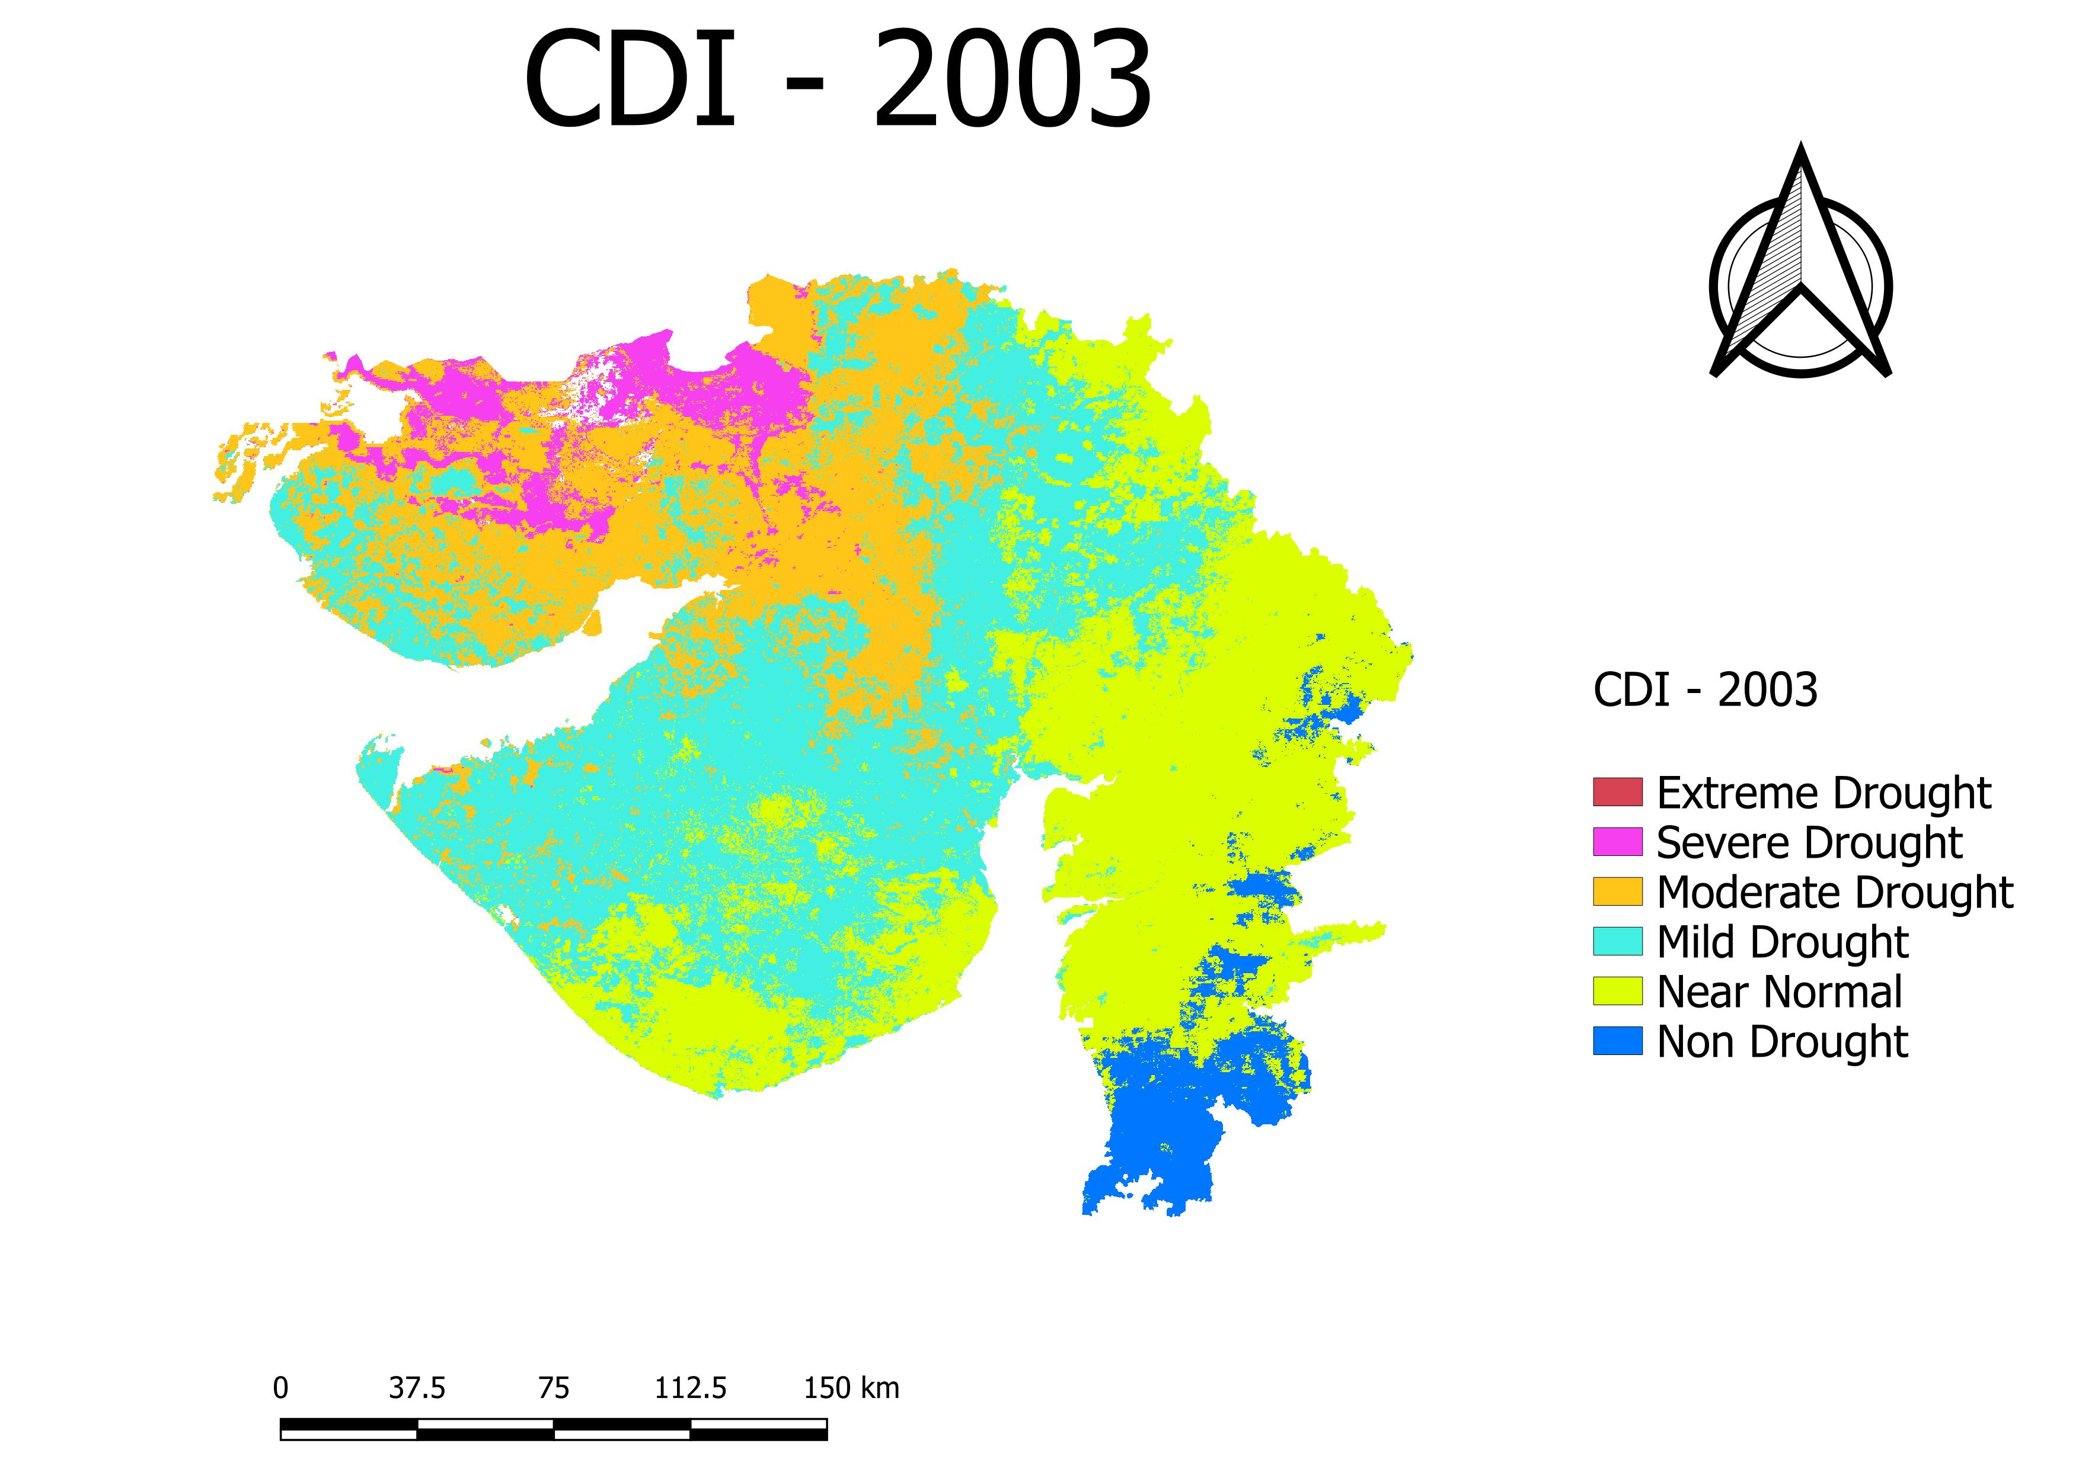
DROUGHT YEAR v/s Normal Year

Slide 15
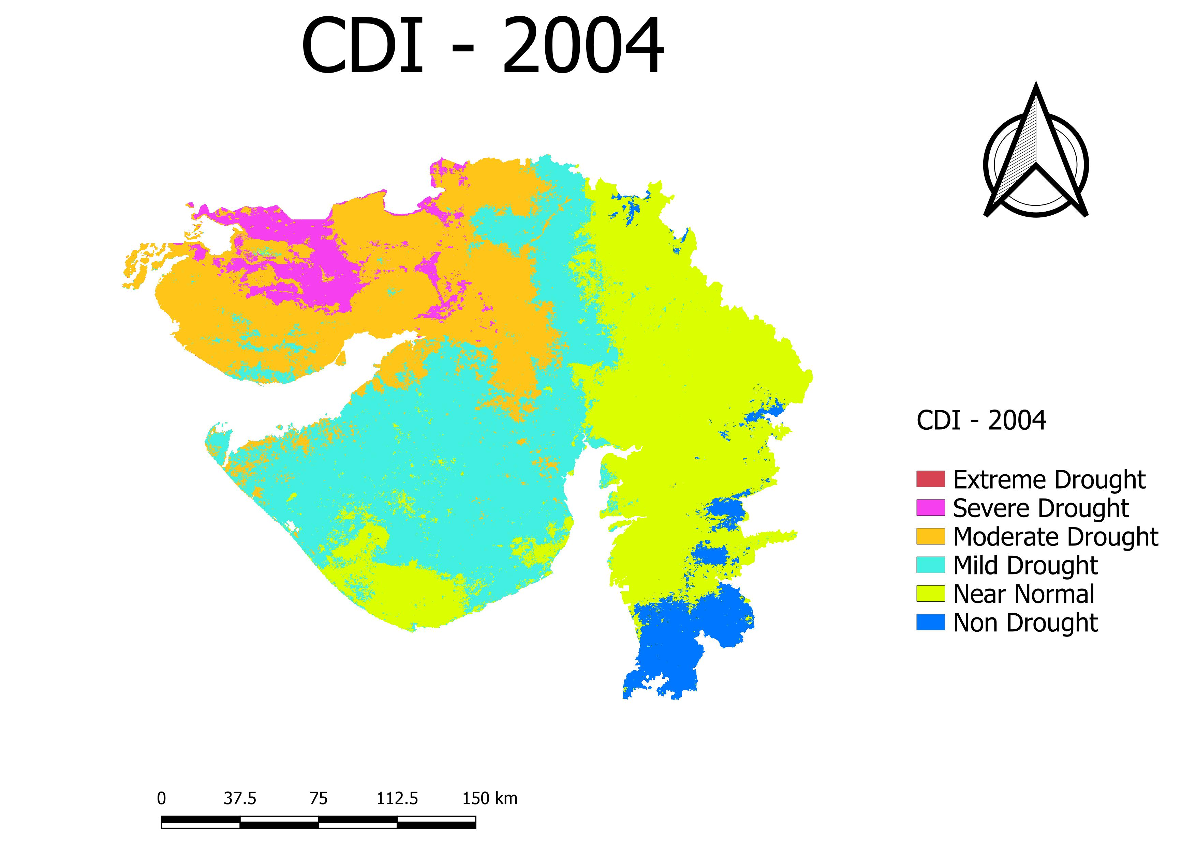
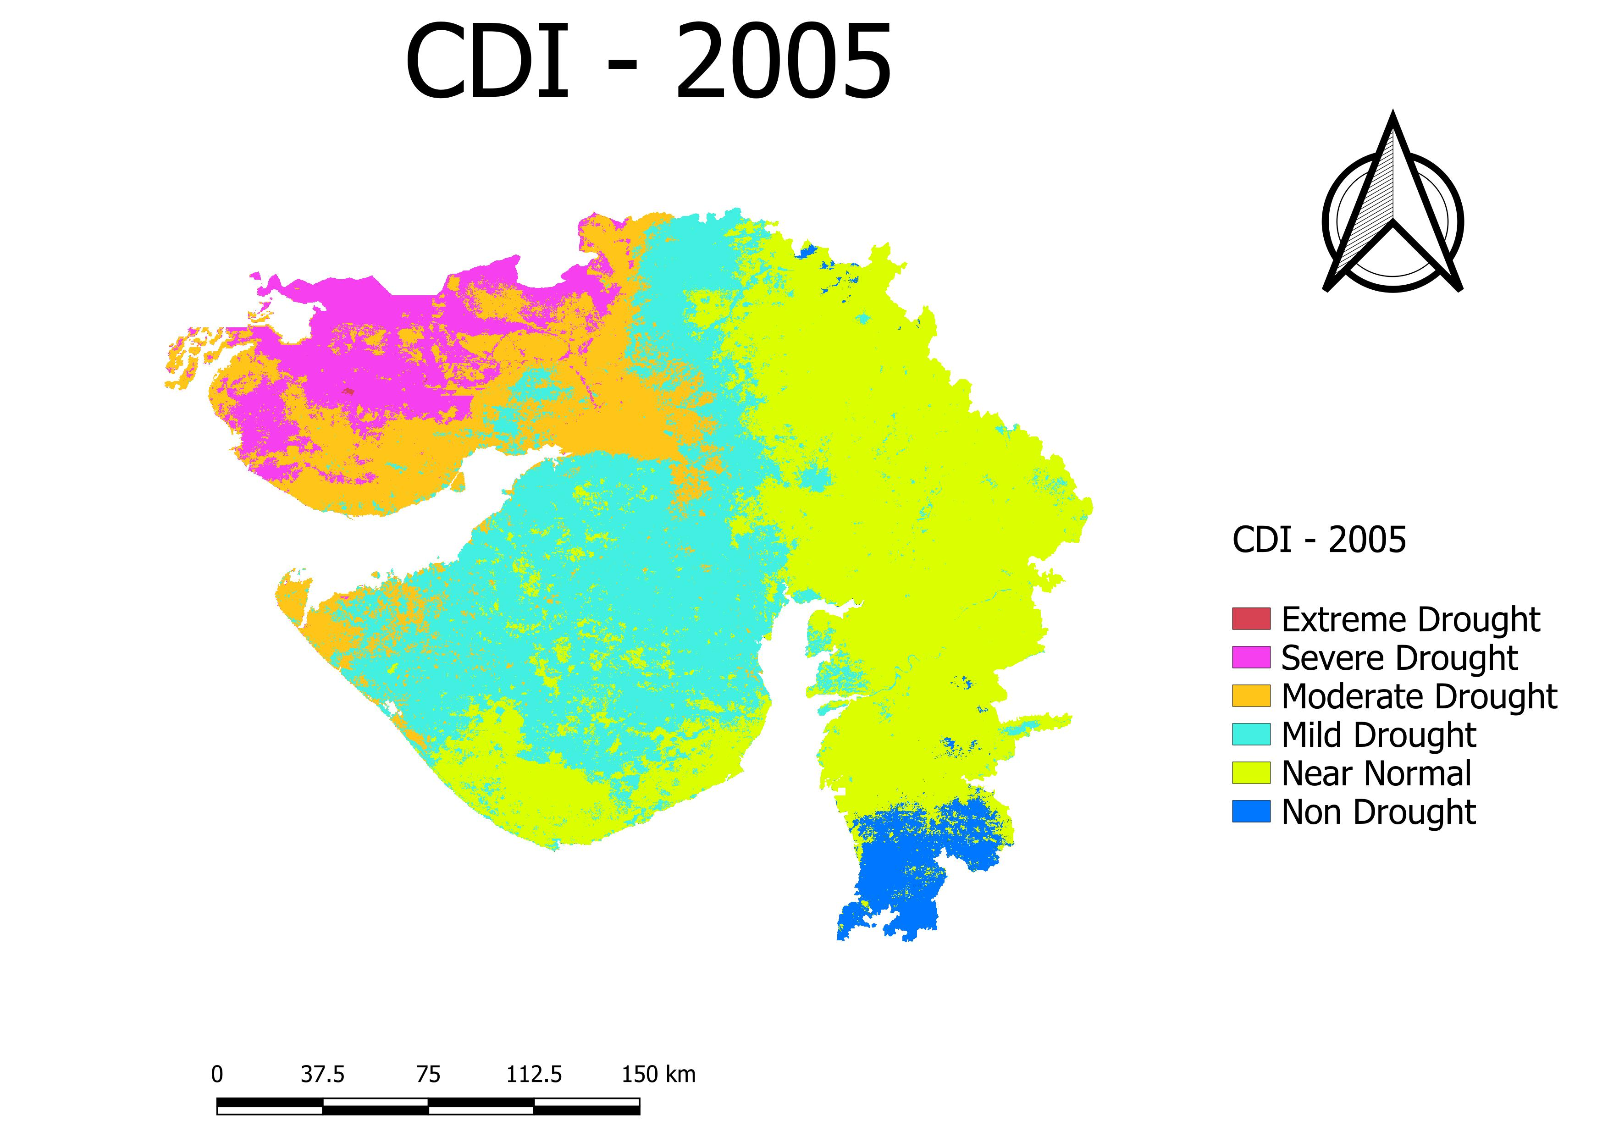
drought YEAR v/s Normal Year

Slide 16
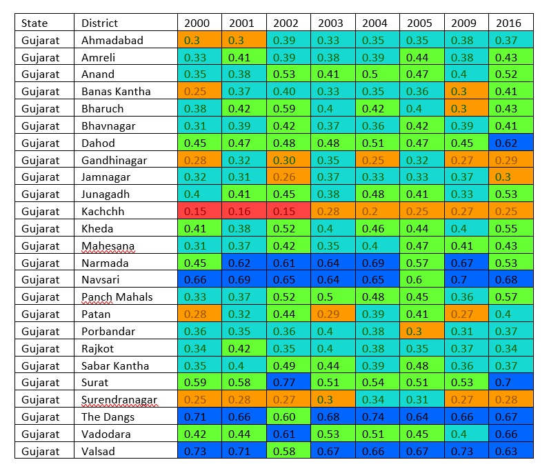
results
From results we clearly see that…
In Gujarat 2000, 2001, 2002, 2004, 2009, 2016 are drought years.
In the Drought Year……
Severe drought regions:- Kachchh, Banaskantha, Saurashtra.
Moderate drought region:- Middle Gujarat
Low drought region:- Valsad, Navsari, Surat and Dang Region.

Slide 17
Future scope
We aim to predict drought conditions using forecasted precipitation and temperature data from the preceding 15 to 30 days.
Analyzing crop yield data alongside drought conditions allows for a more precise assessment of the severity of drought conditions.
Beyond satellite imagery, we can integrate diverse data sources such as climate models, weather station data, and socio-economic indicators. By combining these datasets, future research can develop comprehensive drought monitoring systems that capture the complex interactions between meteorological, hydrological, and socio-economic factors.

Slide 18
Thank you ….

Slide 19
Analytical hierarchical process (ahp) derived weightage analysis under multi-criteria decision-making (Mcdm) technique
MCDM-based AHP approach integrates multi-criteria/variables/factors in hierarchic structure for weightage analysis using paired comparison and matrix formation which confirm the reliability in judgement.
MCDM is widely used technique where weightage assessment is going to finalized based on suitability selective criteria built by decision makers.
AHP is going to use for rating assignment in increasing trend of scale from 1 to 9 based on contributing value as the lowest to highest value.
Based on previous studies as reference, expert knowledge and subject specific experience are the key parameters for the criteria finalization and judgement.

